Slide 1










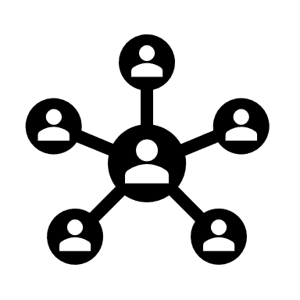


Register Different Redirect URL for different roles in Azure AD
Terraform Apply
Terraform
Azure AD & MFA
Cloud Watch
& Cloud Trail
Splunk HTTP
Event Collector
AWS EKS
Logs & Reports
Redirect URL
Admin Service
Platform Service
SSO Login Flow
Roles/Actors
1. Team
2.PlatfoAdminrm Team
3.User/System
Pub & Sub Service
System/User Service
Snowflake
ALB
(Application Load Balancer)
User
Internet
Self Service Portal (SPA)
Email
Angular Client
Amazon SNS
Notification
S3 Bucket
DynamoDB

